Slide 1
Innovative Topical Antifungal

Slide 2
onychomycosis
Fungal Infection of nails and toes
Caused by dermatophytes
Infect the nail plate and nail bed
Causes nails deformation, discoloration and thickening
Causes pain and social embarrassment

Slide 3
Onychomycosis Market
35 million people in the US
95% of Onychomycosis infections are of toenails
47% of patients not receiving treatement

Slide 4
US Onychomycosis Market

Slide 5
Treatment options
Nail debridement
Oral medication (systemic)
Topical medication
Combination of nail debridement and medication

Slide 6
Lamisil
Worldwide sales $1.2 Billion-2004
1.4 Million new prescriptions per year in the US-2010
Efficacy rate = 38% (Standard of Care)

Slide 7
Lamisil limitations
Safety concerns : Liver Toxicity
Multiple drug-drug interactions and multiple drug-food interactions
Efficacy rate only 38% with high relapse rate leading to patients redoing other courses of treatement
Multiple doctor visits and follow-ups

Slide 8
Topical treatement
Creams and solutions are not effective (cannot penetrate the nail structure)
Only Penlac ® Lacquer is approved for treatement
US sales $125 Million in 2002
350 000 new prescriptions /year-2010

Slide 9
Penlac Limitations
Low labelled efficacy (5.5 - 8.5%)
Need to use nail polish remover before applying the next coat

Slide 10
Conclusion
Onychomycosis market is still in search for a topical product that can penetrate the nail plate and provide :
→100% clear nail
→Infection cure

Slide 11
Introducing
RAF02

Slide 12
Raf02 features
Topical liquid formulation
Non-irritant
High effective penetration to the nail bed
Stable at room temperature

Slide 13
Raf02 Features (Cont.)
Dissolves high % of Active Antifungal
Sustained release formulation
Protective coat
No need to use nail polish remover

Slide 14
Raf02 Features (cont.)
Provides a protective membrane
Preservative free
Clinically tested with higher cure rates
Ingredients FDA approved

Slide 15
Raf02 clinical experience
12 patients with fungal infection of the nail and toenail have used RAF02
100% cure rate

Slide 16
Raf02 Road map
Formulation Design ✔
Research & Development ✔
Clinical Testing ✔
Further Research & Development✔
Application for a Patent ✔
Strategic Partnering

Slide 17
Raf02 Road map (cont.)
Venture Capital Financing
FDA approved Clinical Trial
FDA Registration
Marketing → $Sales

Slide 18
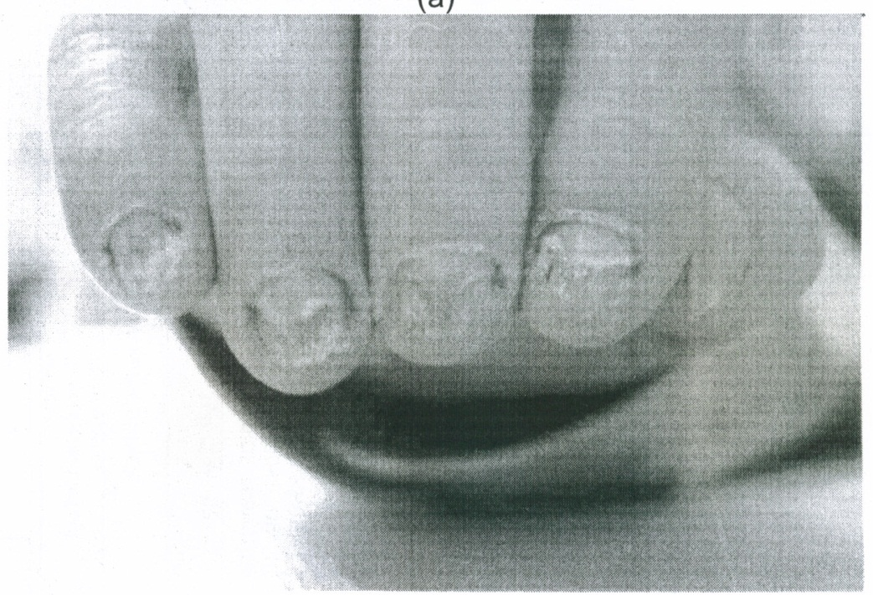
Raf02 Clinical Results
Before Treatment with RAF02

Slide 19
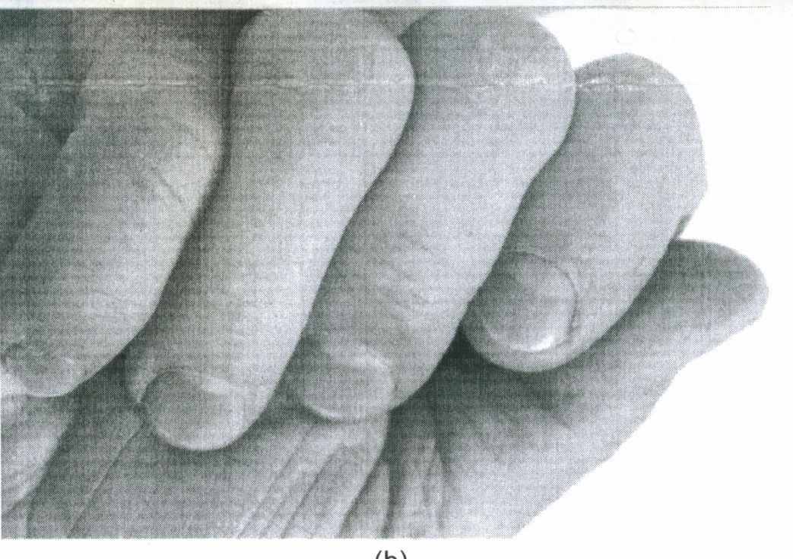
Raf02 Clinical Results
After Treatment with RAF02

Slide 20
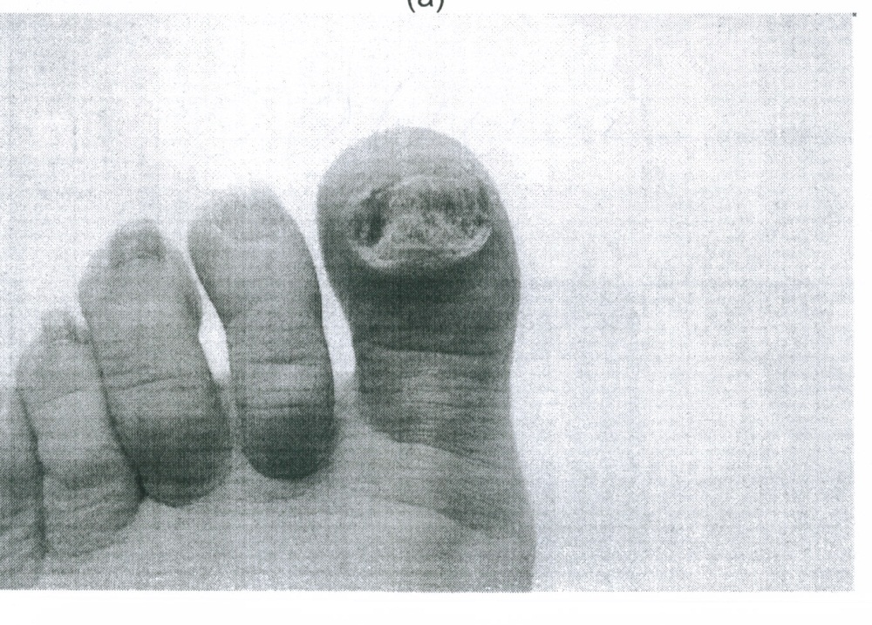
Raf02 Clinical Results
Before Treatment with RAF02

Slide 21
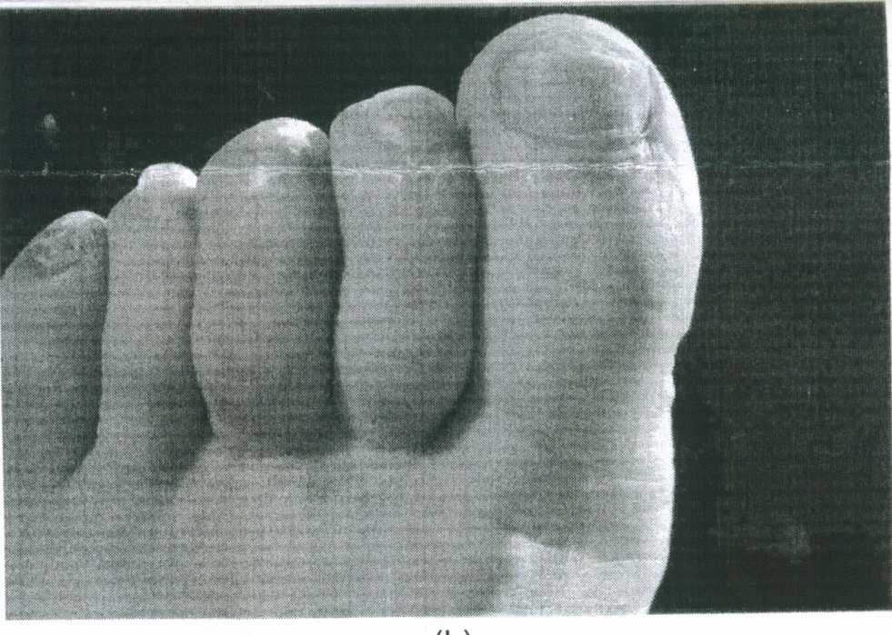
Raf02 Clinical Results
After Treatment with RAF02

Slide 22
RAF02
Contact Information:
Samy Saad, R.Ph.
Managing Director
Richpoint Pharma
10815 Yonge Sreet, Richmond Hill
Ontario L4C3E3 Canada
(416) 877-2793
ssaad@richpointpharma.com

